Slide 1
BIOMEDIN 215 Data Science in Medicine
Nigam Shah, MBBS, PhD
nigam@stanford.edu

Slide 2
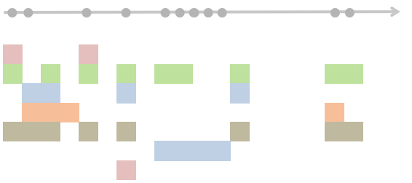
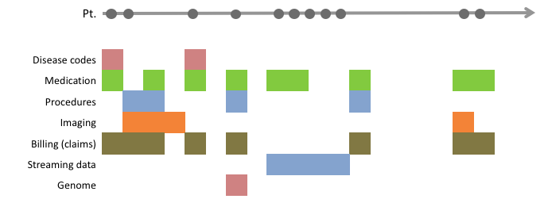
Signposting: Timelines to datasets
1 | 0 | -1
1 | 0 | -1
1 | 0 | -1
1 | 0 | -1
← Persons →
Drugs
Diseases
Devices
Procedures
← Time →
← Features →
The basics:
The anatomy of the healthcare system
The research questions and study designs
The sources of, and errors in, the data used
Using knowledge graph/s of things, and relationships
The choices:
The source and choice of features
How much to agonize over textual data
On the handling of time
In defining an electronic phenotype

Slide 3
Quick recap:
Transforming data into analysis ready datasets.
Feature spaces can be reduced using knowledge-graphs or via data-driven methods.
You can create new features from the raw data.
Missing data can be imputed with varying levels of sophistication (but be careful!).
Your effectiveness in doing these tasks will increase by knowing some biology and medicine.
Text is one source to mine
[be careful how deep you go!]
Notes:
How do you turn messy data into a dataset to analyze?
What is the impact of these methods on the answers we get to our clinical questions?

Slide 4
Traditional Time-Series Data
patient | Feature 1 | Feature 2 | time
1 | 10 | 7.2 | 1
1 | 57 | 7.4 | 2
1 | 8 | 7.3 | 3
1 | 6 | 6.2 | 4
2 | 56 | 4.2 | 1
2 | 88 | 6.8 | 2
2 | 92 | 5.4 | 3
… | … | … | …
Synchronous, fixed-interval, fixed datatype =>
easy to analyze
Patient timelines
t=1
t=2
t=3
…

Slide 5
Healthcare “time series”
Pt.
Disease codes
Medication
Procedures
Imaging
Billing (claims)
Streaming data
Genome
Multiple timescales (heart rate vs. development of kidney disease)
Asynchronous sampling (measurements taken when clinically necessary)
Indicators vs. values (diagnoses, acute v. chronic, procedures, lab tests)

Slide 6
Goals for today
Thinking about time scales of:
the research question
the relevance of data items
Decisions in working with timelines
Tradeoffs in representing time in your dataset.
Timing of outcomes and exposures, and why does it matter.
Nonstationarity: what is it, why does it matter, where does it come from

Slide 7
1. Timescale (of question, of data)

Slide 8
Timescales in Research Questions
Does exposure to asbestos cause mesothelioma?
Who is going to get sepsis?
How many beds should we have in the ICU at any given time?
Who will progress from CKD stage 4 to stage 5?
timescale
seconds
hours
days
years
decades

Slide 9
Think back to the clinical research question you came up with in week one or think of a new one.
What timescale(s) are relevant to your question?
think quietly for a minute

Slide 10
Timescales in Research Questions
Who is going to get sepsis?
Who will progress from CKD stage 4 to stage 5?
Does exposure to asbestos cause mesothelioma?
How many beds should we have in the ICU at any given time?
seconds
hours
days
years
decades
timescale
Notes:
Blood oxygen level
Heartrate (Beats per minute)
Peripheral Artery disease: Ankle Brachial index, Claudication distance, medications
PCR result for viral load detection for SARS-COV-2
Imaging (x-ray, MRI, etc). E.g. Mammogram results
Heart disease: code, angiogram, EKG result, LDL Cholesterol, genetic test for familial hypercholesterolemia
Date of bone marrow transplant
Hypertension: diagnosis, blood pressure, the medication
Kidney function: Creatinine, urine albumin, GFR, ICD codes
Blood Type
DOB and DOD

Slide 11
Breakout: Timescales in Data
1. Blood oxygen level
2. Heartrate (Beats per minute)
3. Peripheral Artery disease: Ankle Brachial index, Claudication distance, medications
4. PCR result for viral load detection for SARS-COV-2
5. Imaging (x-ray, MRI, etc). E.g. Mammogram results
6. Heart disease: code, angiogram, EKG result, LDL, genetic test for familial hypercholesterolemia
7. Date of bone marrow transplant
8. Hypertension: diagnosis, blood pressure, the medication
9. Kidney function: Creatinine, urine albumin, GFR, ICD codes
10. Blood Type
11. Date of Birth and Date of Death
12. Ethnicity
1. Where would data about that item most likely be found in an EHR: e.g. lab result, vitals, diagnosis codes, procedure codes, etc. and write it on the post it note
2. How long after collecting that data would it still be generally informative?
Notes:
Would this piece of information be generally useful to know “X” amount of time after it has been collected?
1. after this is all done, walk along the timescales and pick a few to read out: ask the group to talk about their answers to these two questions
2. Ask for reflections and trends

Slide 12
Relevance timescale of data
Different kinds of data are relevant for different timescales.
The relevant timescales are often dictated by the kind of measurement (e.g. lab test vs. diagnosis), and type of disease (acute vs. chronic disease)
The relevant timescales depend on the question that you want to answer.

Slide 13
Most analyses require numerical data in a “data frame”
ID
1
2
3
4
5
...
Time?
← Patients→
← Features →

Slide 14
2. Working with timelines
Notes:
Creating, and working with time lines (intersect, union)
Working with the partial order among events

Slide 15
Forcing clinical data into a time-series
patient | Feature 1 | Feature 2 | time
1 | 10 | ? | 1
1 | ? | 7.4 | 2
1 | ? | 7.3 | 3
1 | ? | ? | 4
2 | 56 | 4.2 | 1
2 | ? | ? | 3
2 | 92 | 5.4 | 4.5
… | … | … | …

Slide 16
What is the proper sample interval?
patient | Feature 1 | Feature 2 | time
1 | 10 | ? | 1
1 | ? | 7.4 | 2
1 | ? | 7.3 | 3
1 | ? | ? | 4
2 | 56 | 4.2 | 1
2 | ? | ? | 3
2 | 92 | 5.4 | 4.5
… | … | … | …
Depends on the timescale for your question and data
Sequence time vs. clock time
Hripcsak, G., Albers, D. J., & Perotte, A. (2015). Parameterizing time in electronic health record studies. Journal of the American Medical Informatics Association, 22(4), 794–804. http://doi.org/10.1093/jamia/ocu051

Slide 17
Is it an imputation problem?
patient | Feature 1 | Feature 2 | time
1 | 10 | ? | 1
1 | ? | 7.4 | 2
1 | ? | 7.3 | 3
1 | ? | ? | 4
2 | 56 | 4.2 | 1
2 | ? | ? | 3
2 | 92 | 5.4 | 4.5
… | … | … | …
patient | Feature 1 | Feature 2 | time
1 | 10 | ? | 1
1 | 10 | 7.4 | 2
1 | 10 | 7.3 | 3
1 | 10 | 7.3 | 4
2 | 56 | 4.2 | 1
2 | 56 | 4.2 | 3
2 | 92 | 5.4 | 4.5
… | … | … | …
patient | Feature 1 | Feature 2 | time
1 | 10 | ? | 1
1 | 10 | 7.4 | 2
1 | 10 | 7.3 | 3
1 | 10 | 7.3 | 4
1 | 10 | 7.3 | 4.5
2 | 56 | 4.2 | 1
2 | 56 | 4.2 | 2
2 | 56 | 4.2 | 3
2 | 56 | 4.2 | 4
2 | 92 | 5.4 | 4.5
… | … | … | …
Last-Value-Carry-Forward (LVCF)
But can you find out, e.g. at what time did this patient first have F1 >56 AND F2< 5.4
Notes:
Is it worth your time?
Will it change the answer you get to your research question?
Are the assumptions of your fancy method really any more justifiable than those of a stupid method like LVCF?

Slide 18
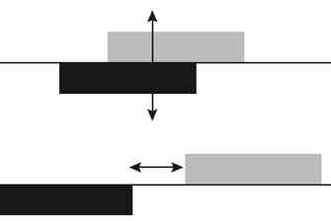
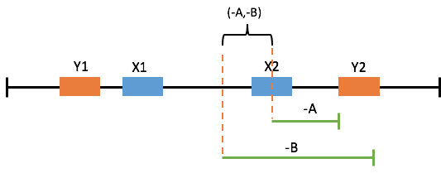
Computing with timelines
Querying timelines
Manipulating sequences of events that have a start and end.

Slide 19
3. Representing time
Notes:
Capturing time in your feature engineering (e.g. wound healing)
Relevance timescale of a feature (e.g. pneumonia)

Slide 20
Representing time by binning
Different diagnoses
Index time
Bin 1
Bin 2
t
0 2 2
1 2 0
Counts in bin 1
Counts in bin 2
← Patients→
demographics
drugs
procedures
diagnoses
labs
visits
← Features →
Notes:
The recent/prior binning makes sense clinically- helps distinguish b/t current, past, and chronic problems.
Visit counts can be a surrogate for socioeconomic indicators, especially in the presence of other features indicating disease severity (e.g. healthy person with a lot of visits…)
Idea: intersect a comorbidity index with visit counts to get a nice hand-crafted “feature” representing socioeconomic status
Date is a good thing to have so we can guard from non-stationarity

Slide 21
Choices in time-binning
t
How many bins?
What granularities of time?
How does this relate to the timescales at play in your research question?
How do you aggregate the data within each bin?

Slide 22
What quantity to use in a time bin?
patient | drug | date
1 | metformin | 1/5/2005
1 | metformin | 5/9/2005
1 | sulfonylurea | 7/2/2005
2 | lisinopril | 4/29/1999
2 | lisinopril | 4/1/2001
2 | metformin | 4/1/2001
2 | lisinopril | 5/2/2001
… | … | …
Without value (indicators):
+ Counts
+ Presence/absence
+ Etc.
patient | Lab Test | Value | date
1 | HbA1c | 7.2 | 1/5/2005
1 | HbA1c | 7.4 | 5/9/2005
1 | HbA1c | 7.3 | 7/2/2005
1 | HbA1c | 6.2 | 9/10/2005
2 | HbA1c | 4.2 | 4/29/1999
2 | HbA1c | 6.8 | 4/1/2001
2 | HbA1c | 5.4 | 5/2/2001
 | … |  | …
With value:
+ Average value in window
+ Most recent value in window
+ Variance of values in window
+ Etc.

Slide 23
Tradeoffs in Time-Binning
What tradeoffs are being made when:
- Including more vs. fewer bins?
- Making bins granular vs. coarser?
- Having more vs. fewer ways to aggregate?
Notes:
Spectrum: ←-----------> for each of these

Slide 24
Recall: Making Better Features
Whose wound is at risk of not healing within 3 months?
patient | size t1 | size t2 | t1 | t2 | healed? | ....
1 | 9 | 9 | 0 | 31 | F
2 | 5 | 2 | 0 | 89 | T
3 | 2 | 3 | 0 | 2 | F
4 | 6 | 1 | 0 | 16 | T
5 | 7 | 6 | 0 | 56 | T
diagnoses %>% mutate(growth_rate = (size_t2-size_t1)/(t2-t1))
a wound that is healing will likely continue to do so
patient | size t1 | size t2 | t1 | t2 | growth rate | healed? | ....
1 | 9 | 9 | 0 | 3 | 0 | F
2 | 5 | 2 | 0 | 9 | -0.33 | T
3 | 2 | 3 | 0 | 2 | 0.5 | F
4 | 6 | 1 | 0 | 15 | -0.33 | T
5 | 7 | 6 | 0 | 1 | -1 | T

Slide 25
4. Timing of exposures, and outcomes

Slide 26
Cohort Studies: Index time of exposure
When did patients “not have” the exposure?
Notes:
using a comparator sometimes changes the question

Slide 27
Explicitly capturing time-to-Event
Exposure
Outcome
Features
Exposure Time
Outcome Time
1
1
1
0
1
0
0
0
…
0
1
0
1
1
1
0
0
…
1/5/2005
1/5/2005
5/9/2005
7/2/2005
9/10/2005
4/29/1999
4/1/2001
5/2/2001
…
?
5/9/2005
?
9/10/2005
4/29/2007
4/1/2001
?
?
…
-
← Patients→
← Features →

Slide 28
Explicitly capturing time-to-Event
Exposure
Outcome
Features
time-to-event
1
1
1
0
1
0
0
0
…
0
1
0
1
1
1
0
0
…
?
113
?
61
605
601
?
?
…
← Patients→
← Features →

Slide 29
Ignoring patients with no recorded outcome
What if we just ignored the patients with no outcome date?
Think quietly for a minute.
Notes:
What if all of the patients who had no outcome recorded were those who weren’t exposed?
e.g. censoring is correlated with the exposure!
you introduce a selection bias

Slide 30
Right-Censored Data
t = T
Censoring
Exposure
Outcome
Features
time-to-event
1
1
1
0
1
0
0
0
…
0
1
0
1
1
1
0
0
…
?
113
?
61
605
601
?
?
…
> T₁
113
> T₃
61
605
601
> T₇
> T₈
…
-
← Patients→
← Features →
Replace with >T where T is the last time we saw these patients in the data
Notes:
Everyone would get the outcome eventually:
If it’s death, we all die
If it’s something else, we would get it if we hadn’t died of something else

Slide 31
Right-Censored Data
t = T
Censoring
Outcome or
Censored
Exposure
Features
time-to-event
1
1
1
0
1
0
0
0
…
0
1
0
1
1
1
0
0
…
?
113
?
61
605
601
?
?
…
> T₁
113
> T₃
61
605
601
> T₇
> T₈
…
88
113
694
61
605
601
1115
198
…
-
← Patients→
← Features →
Notes:
Now the “outcome” column indicates if the time-to-event is a time-to-outcome or if it’s a time-to-censoring.
Subtle change in the question.

Slide 32
You have limited resources:
Use feature engineering to represent time in the features.
Understand the relevance duration of a data item (i.e. HbA1c measurement) over time.
Make sure the timing of the outcome and exposure of interest are correct. Get index time right.
Notes:
Call for justifications
What does a “misclassification bias” look like for time-to-event?

Slide 33
5. Non-stationarity

Slide 34
Nonstationarity: Can you use old data?
Did the process that generated your data change over time?
Changes in coding standards
Changes in clinical practice
Impacts:
True association changes over time
Predictors no longer useful
Notes:
Example change in coding practice:

Slide 35
Recall:
The rate of hospitalizations with a principal diagnosis of pneumonia decreased by 27% from 2003 to 2009 while in-hospital mortality decreased by 28%.
During the same period, rates of hospitalization for sepsis and respiratory failure with a secondary diagnosis of pneumonia increased by 178% and 9%, respectively.

Slide 36
Assigned reading
Barnett I, Torous J, Staples P, Keshavan M, Onnela JP.
Beyond smartphones and sensors: choosing appropriate statistical methods for the analysis of longitudinal data.
J Am Med Inform Assoc. 2018 Dec 1;25(12):1669-1674. PMID: 30272176; PMCID: PMC6658863.
Lecture 10, preparation assignment.
3 steps, need to complete step 2 before trying step 3
Notes:
Data and questions span many timescales, with irregular time intervals
In working with timelines, ordering of events is crucial.
We can use time explicitly (time-series, time-to-outcome) or implicitly (binning)
Timing of exposures and outcomes is crucial. Spend effort getting index time right.
Clinical processes are often nonstationary

